Slide 1
Designing Stimuli (or Anything) Reproducibly
Jack E. Taylor
SIPS 2021
https://jackedtaylor.github.io/SIPS2021/

Slide 2
Today’s Session
How can we design lists of stimuli reproducibly?
Focusing on “sample” stimuli
Explain methods, then show example code
Can implement solutions in other languages (e.g., Python, MATLAB, Julia, Javascript, heck even Excel formulas)
No programming knowledge necessary to understand what’s going on
Some programming knowledge necessary to apply the methods yourself
Website with slides and example code:
https://jackedtaylor.github.io/SIPS2021/

Slide 3
This Session 15-20 minute sections 5ish minute breaks
Designing Stimuli (or Anything) Reproducibly
What do we mean by stimuli?
What do we mean by reproducibility?
How can we generate stimuli reproducibly?
Item-wise versus distribution-wise approaches
Distribution-wise matching
Assumption-free distribution-wise matching
Item-wise matching
LexOPS
Propensity score matching
Matching continuous independent variables
Reporting matching in Methods sections
Applications to things other than designing stimuli
Summary, Questions, and Answers
1)
2)
3)
4)

Slide 4
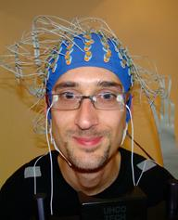
Introductions
PhD student at University of Glasgow
Psycholinguistics: Orthography and Semantics
EEG Research
Word nerd
Cat Person
One of those people who will spend 2 hours writing reproducible functions if it means I don’t have to spend 20 minutes doing something by hand
Currently looking for Post-Doctoral positions
Part 1/4
Sara Sereno
Guillaume Rousselet

Slide 5
What is a Stimulus?
Anything you present to a participant to elicit a response
One stimulus = Something presented on a single trial

Slide 6
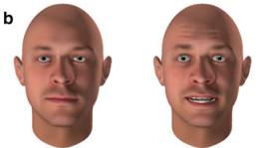
“PARAMETRIC” STIMULI
spinkle
Can use any combination of multiple parameters to generate novel items
Potentially infinite in number
Parameters defining the stimulus known exactly
E.g., pseudowords, procedurally generated faces
“SAMPLE” STIMULI
orange
Sampled from a population of existing items
Only a finite number of candidates
Parameters defining the stimulus have to be inferred
E.g., real words, images of real faces

Slide 7
What is a control variable?
A potentially confounding variable which you don’t want to pollute your effect of interest
parametric stimuli: just create items which do not differ in the control variable
sample stimuli: identify and select items such that the control variable doesn’t confound your effect of interest

Slide 8
Reproducibility
Can other people reproduce the method by which you generated your stimuli?
For parametric stimuli, you can just share the code
Are sample stimuli reproducible?

Slide 9
How do people report picking their “sample” stimuli?
“The two conditions were matched in terms of word length, word frequency, and age of acquisition. Independent sample t tests confirmed that the conditions were suitably controlled (all p values > .05).” - Foo et al. (2005): Revisiting the Effect of Bar
“Items in the two conditions were matched pairwise in terms of word length, word frequency, and age of acquisition. Paired sample t tests confirmed that the conditions were suitably controlled (all p values > .05).” - Foo et al. (2003): The Effect of Bar on Word Recognition

Slide 10
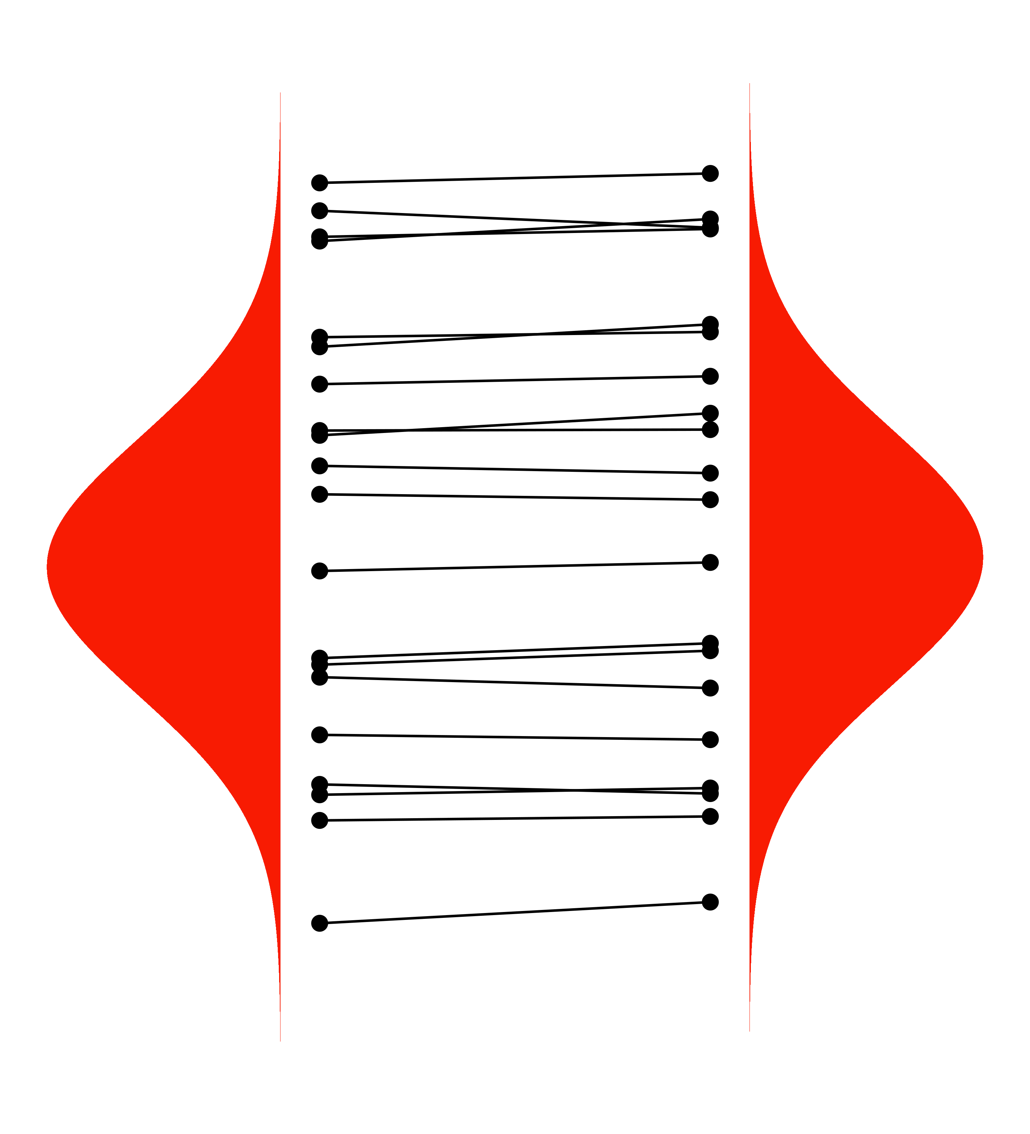
How are people picking their “sample” stimuli?
Distribution-Wise Matching
Item-Wise Matching

Slide 11
Distribution-Wise Approaches to Matching
Part 2/4

Slide 12
Distribution-Wise Matching
The full distribution in one condition is matched with the full distribution in the other.
Results in independent conditions which are similarly distributed on control variables.
Can control how precise this matching is.

Slide 13
Distribution-Wise Matching Manually
How are people currently matching distributions?
Identify/create databases with the variables you need.
Identify filters and apply.
Identify conditions, and get lists of items that fit each condition.
Try to pick items which balance each other out across the conditions.
Check the conditions are similarly distributed using a statistical test or comparing means and SDs.

Slide 14
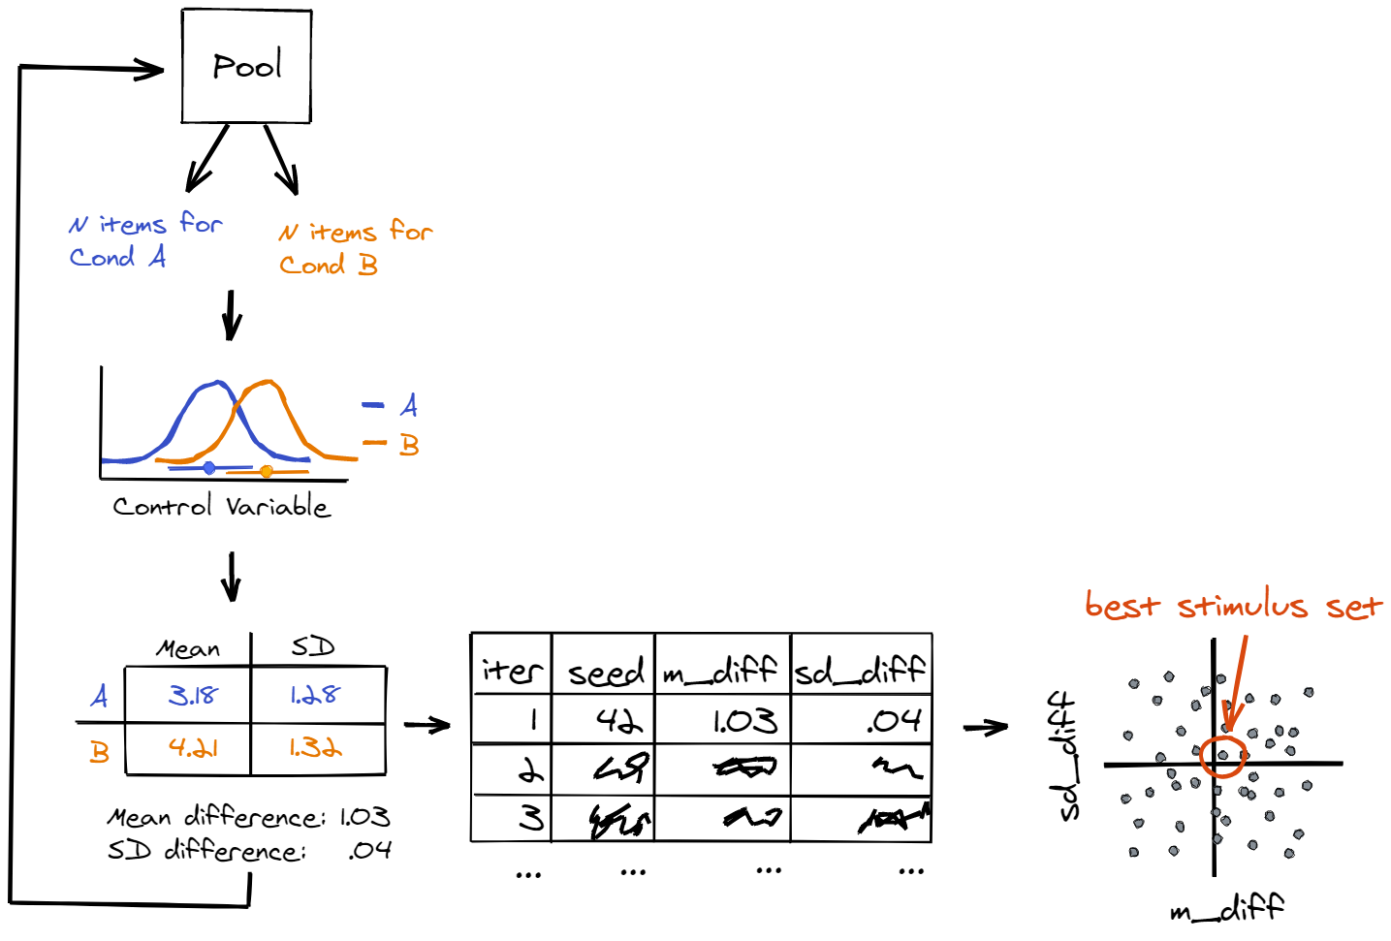
DISTRIBUTION-WISE MATCHING WITH CODE
Randomly pick a sample of items which fits the conditions.
Calculate a summary statistic for how close the samples are
Store the result and a seed to recreate the stimuli
Repeat the process many times
Select the best stimulus (e.g., smallest difference in mean and SD)

Slide 15
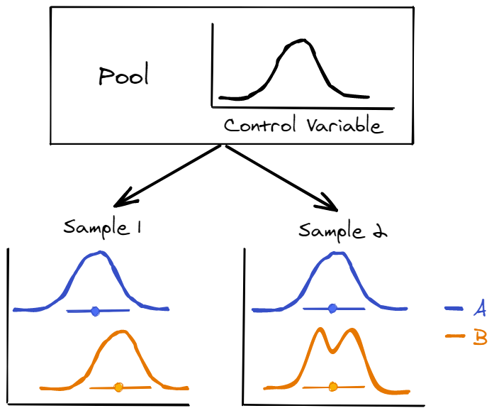
What’s wrong with matching on distributional parameters?
Need to specify a distribution that describes the variable well
Variable might not have that distribution in a random sample anyway
Could add a check for appropriateness of the distribution assumptions
Or…
Could use an assumption-free measure of distributional similarity

Slide 16
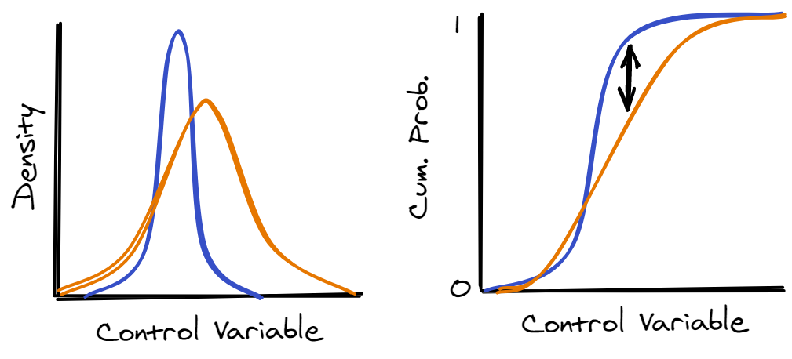
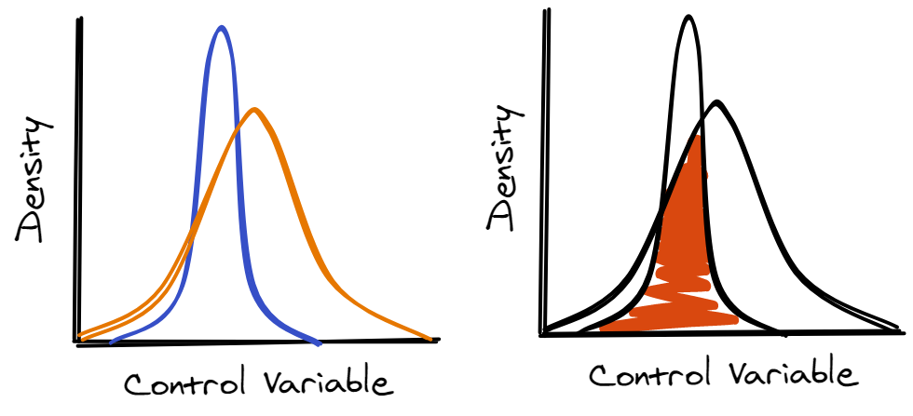
Assumption-Free Measures of Distributional Similarity
Kolmogrov-Smirnov Statistic (Kolmogrov, 1933; Smirnov, 1948)
Overlapping Index (Pastore & Calcagni, 2019)

Slide 17
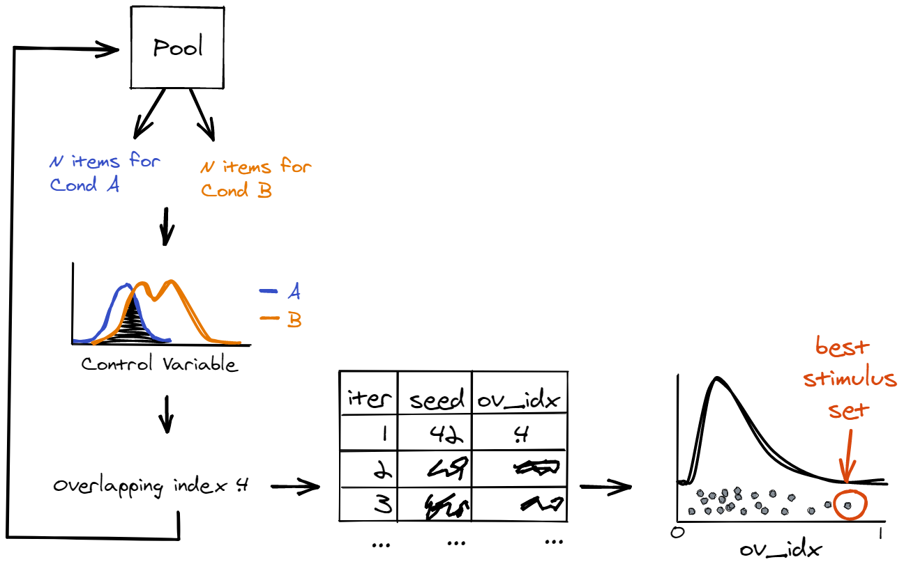
ASSUMPTION-FREE DISTRIBUTION-WISE MATCHING
Randomly pick a sample of items which fits the conditions.
Calculate a summary statistic for distributional similarity
Store the result and a seed to recreate the stimuli
Repeat the process many times
Select the best stimulus (e.g., largest overlapping index)

Slide 18
A distribution-wise example with code

Slide 19
What else could we implement with distribution-wise matching?
Filtering the pool
Matching multiple variables simultaneously
Weighting distributional similarity
Maximising representativeness as distributional similarity to the pool

Slide 20
Item-Wise Approaches to Matching
Part 3/4

Slide 21
Item-Wise Matching
Each item is matched with one item in every other condition.
Results in items across conditions that are directly comparable to one another.
Can control how precise this matching is.
Distributional similarity is a necessary by-product of item-wise matching.
Degree of distributional similarity is defined by the precision of the matching.

Slide 22
Item-Wise Matching Manually
How are people currently matching items?
Identify/create databases with the variables you need.
Identify filters and apply.
Identify conditions, and get lists of items that fit each condition.
Pick an item in either condition.
Try find an item in the other condition which is closely matched in the control variables.
If you find a match, make note of it and remove both items from the pool.
Repeat steps 4 – 6 until you have as many stimuli as you want.

Slide 23
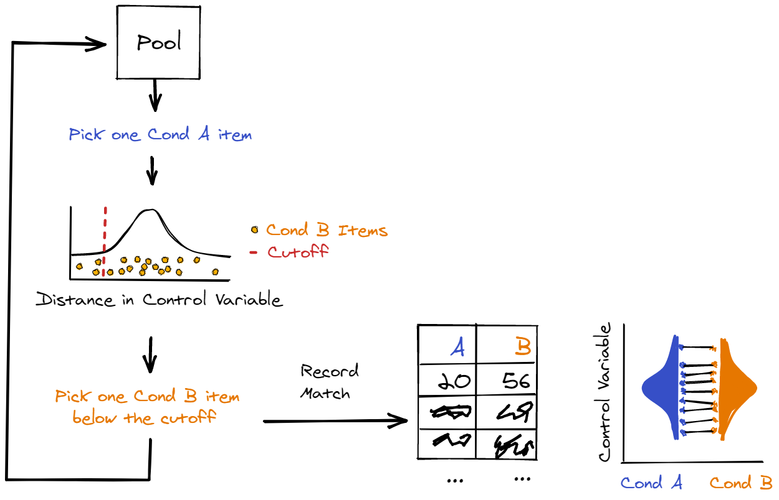
ITEM-WISE MATCHING WITH CODE
Randomly pick an item from one condition.
Try find one item from every other condition which is suitably close in the control variables.
If you find a match, record it.

Slide 24
https://github.com/JackEdTaylor/LexOPS

Slide 25
An R package for generating item-wise matches in a reproducible way.
Similar in style to the tidyverse, focusing on readability.
Some R knowledge required, but there is a Shiny app for users less familiar with R.

Slide 26
Three main functions in LexOPS
split_by()
specify independent variables
1
control_for()
specify control variables
2
generate()
run the matching algorithm
3

Slide 27
An item-wise example with code

Slide 28
Validating LexOPS
How do LexOPS stimuli compare to hand-picked stimuli?
Found four well-controlled studies which provided enough detail to recreate the design in LexOPS
Altered control parameters iteratively to find better matches than the original studies’ stimuli

Slide 29
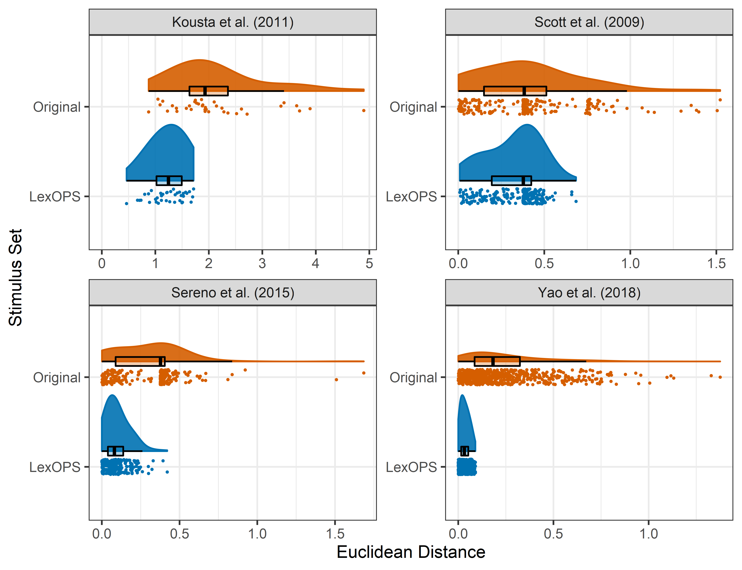
Validating LexOPS

Slide 30
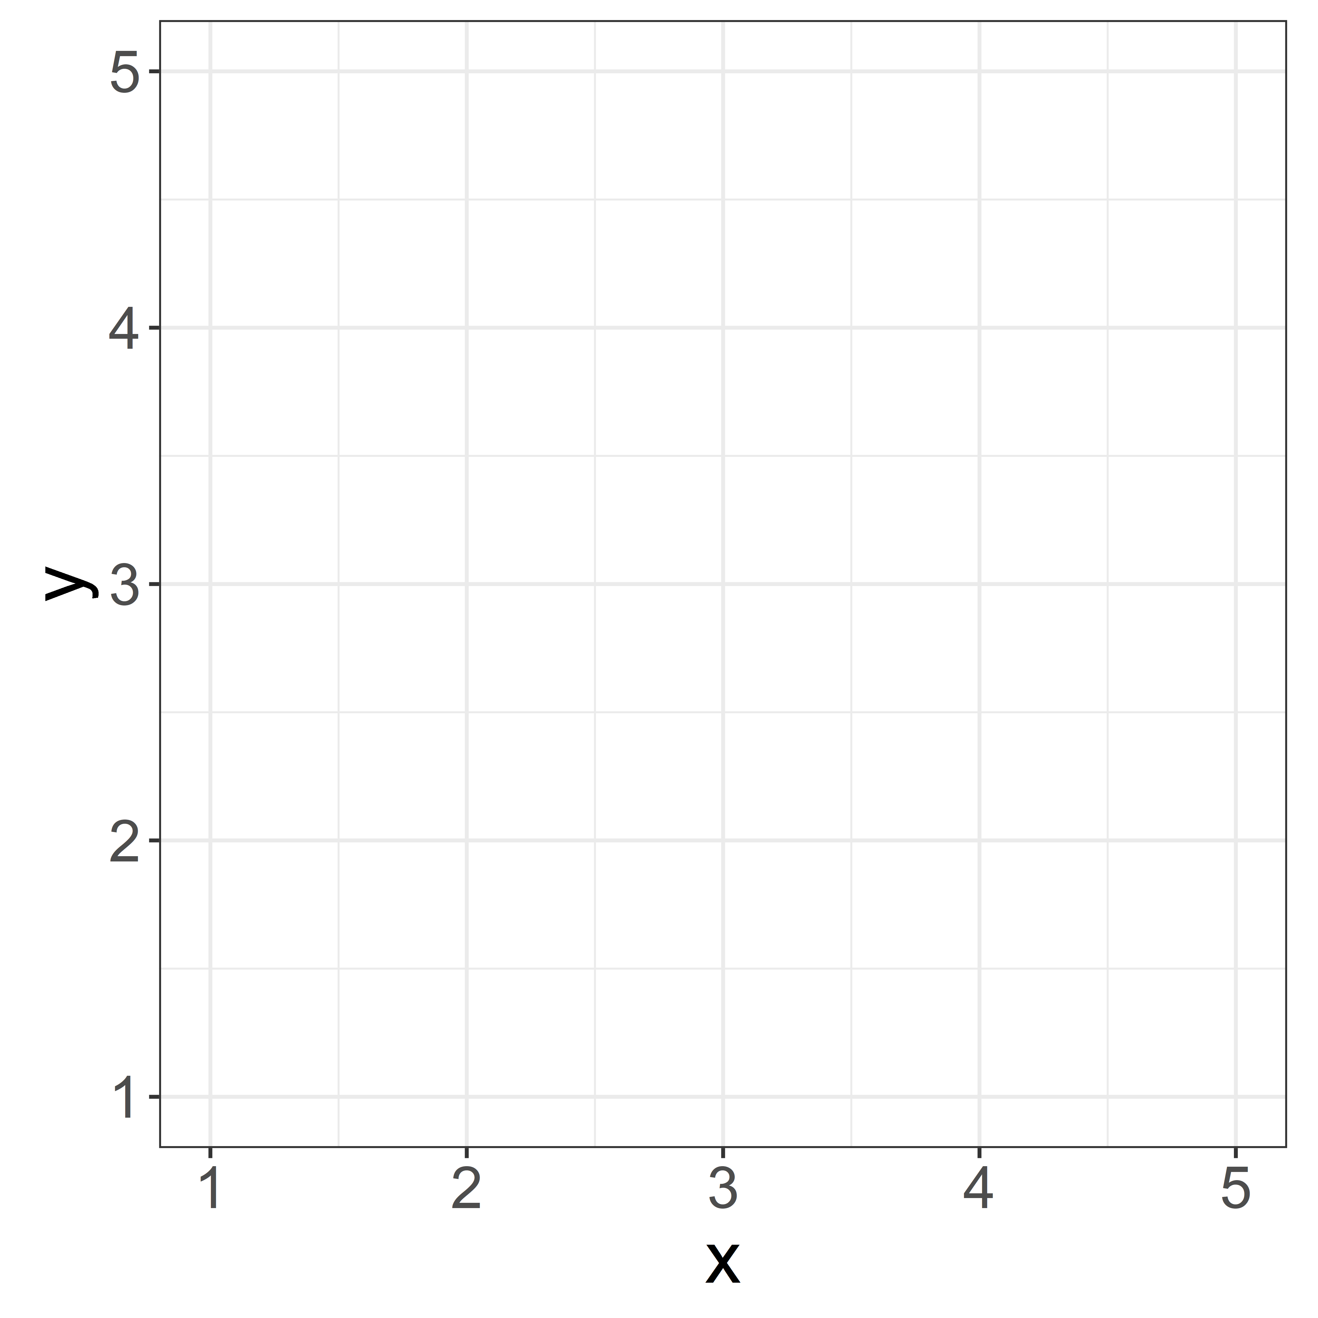
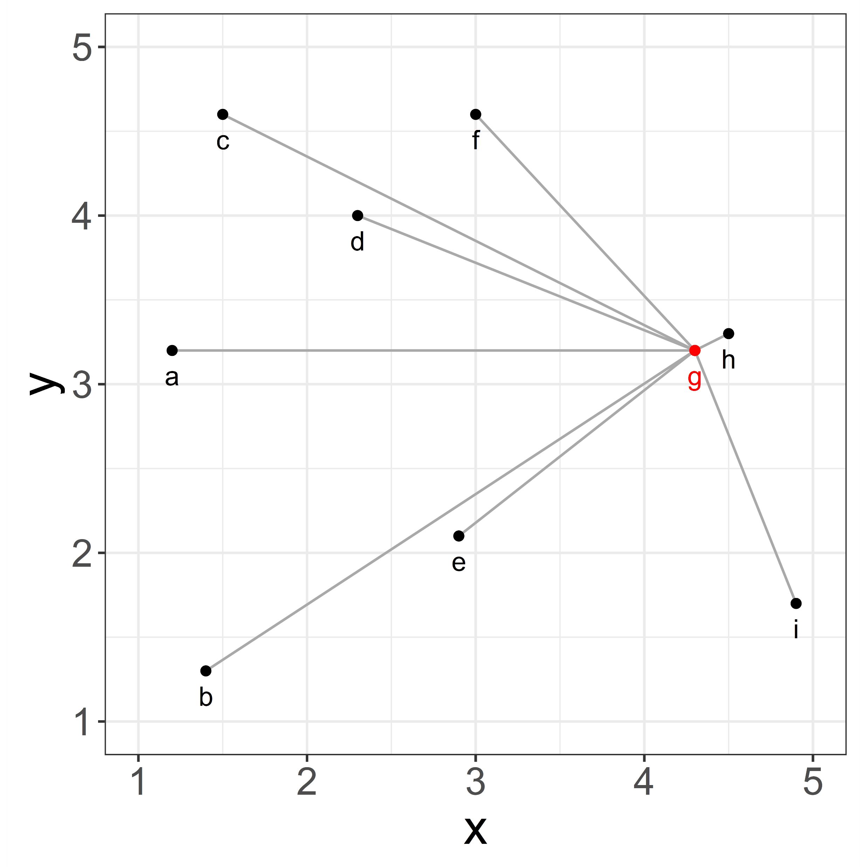
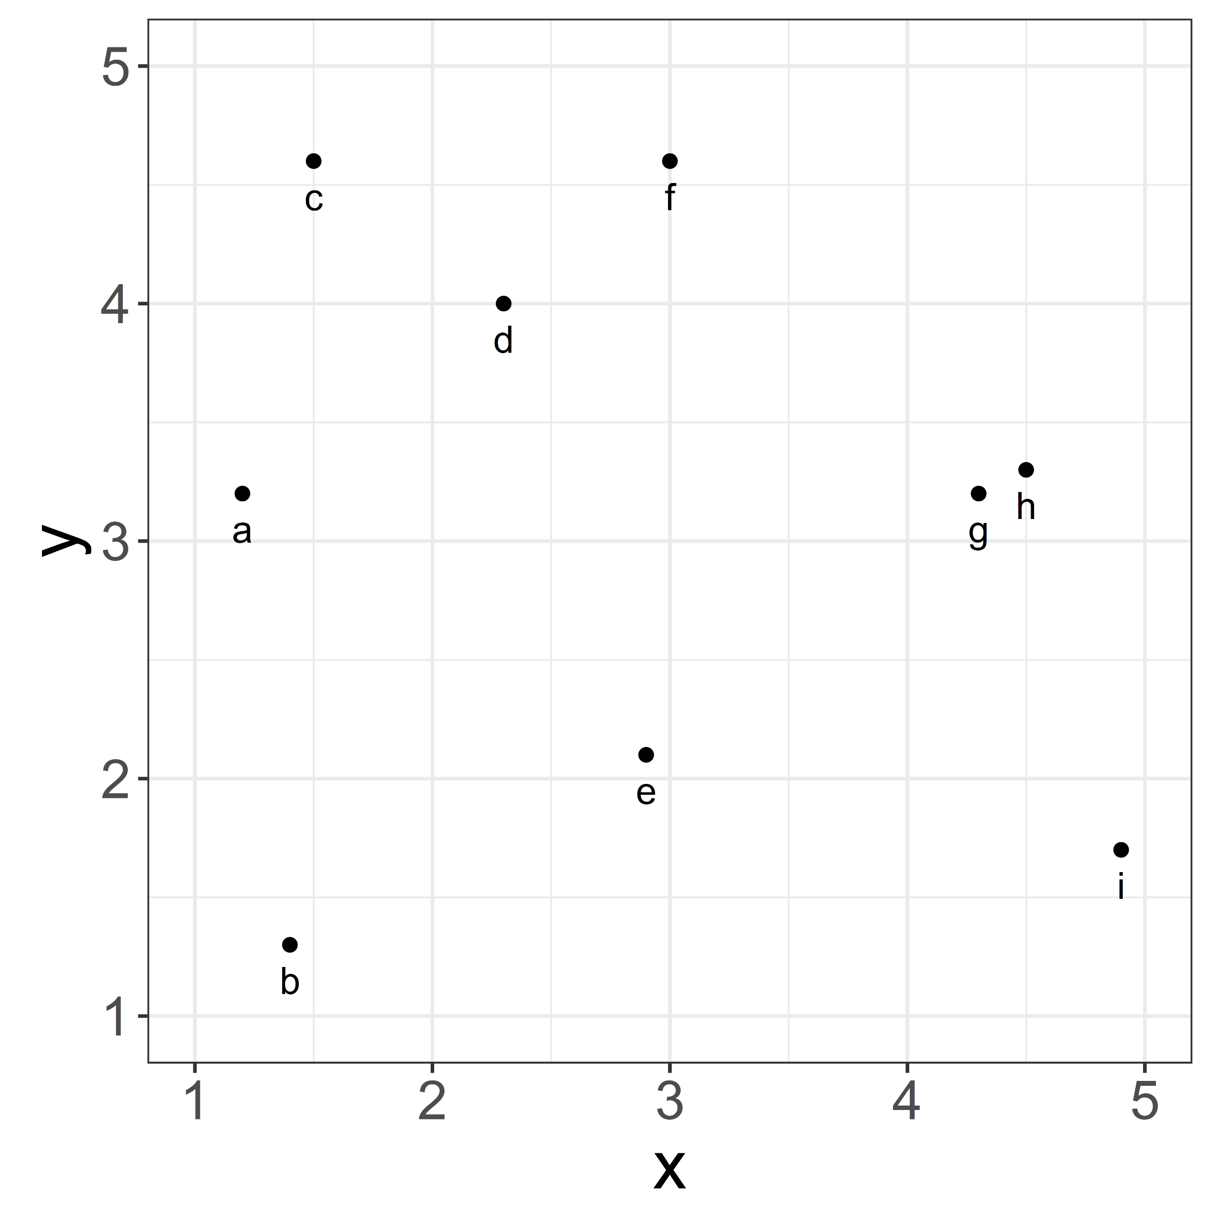
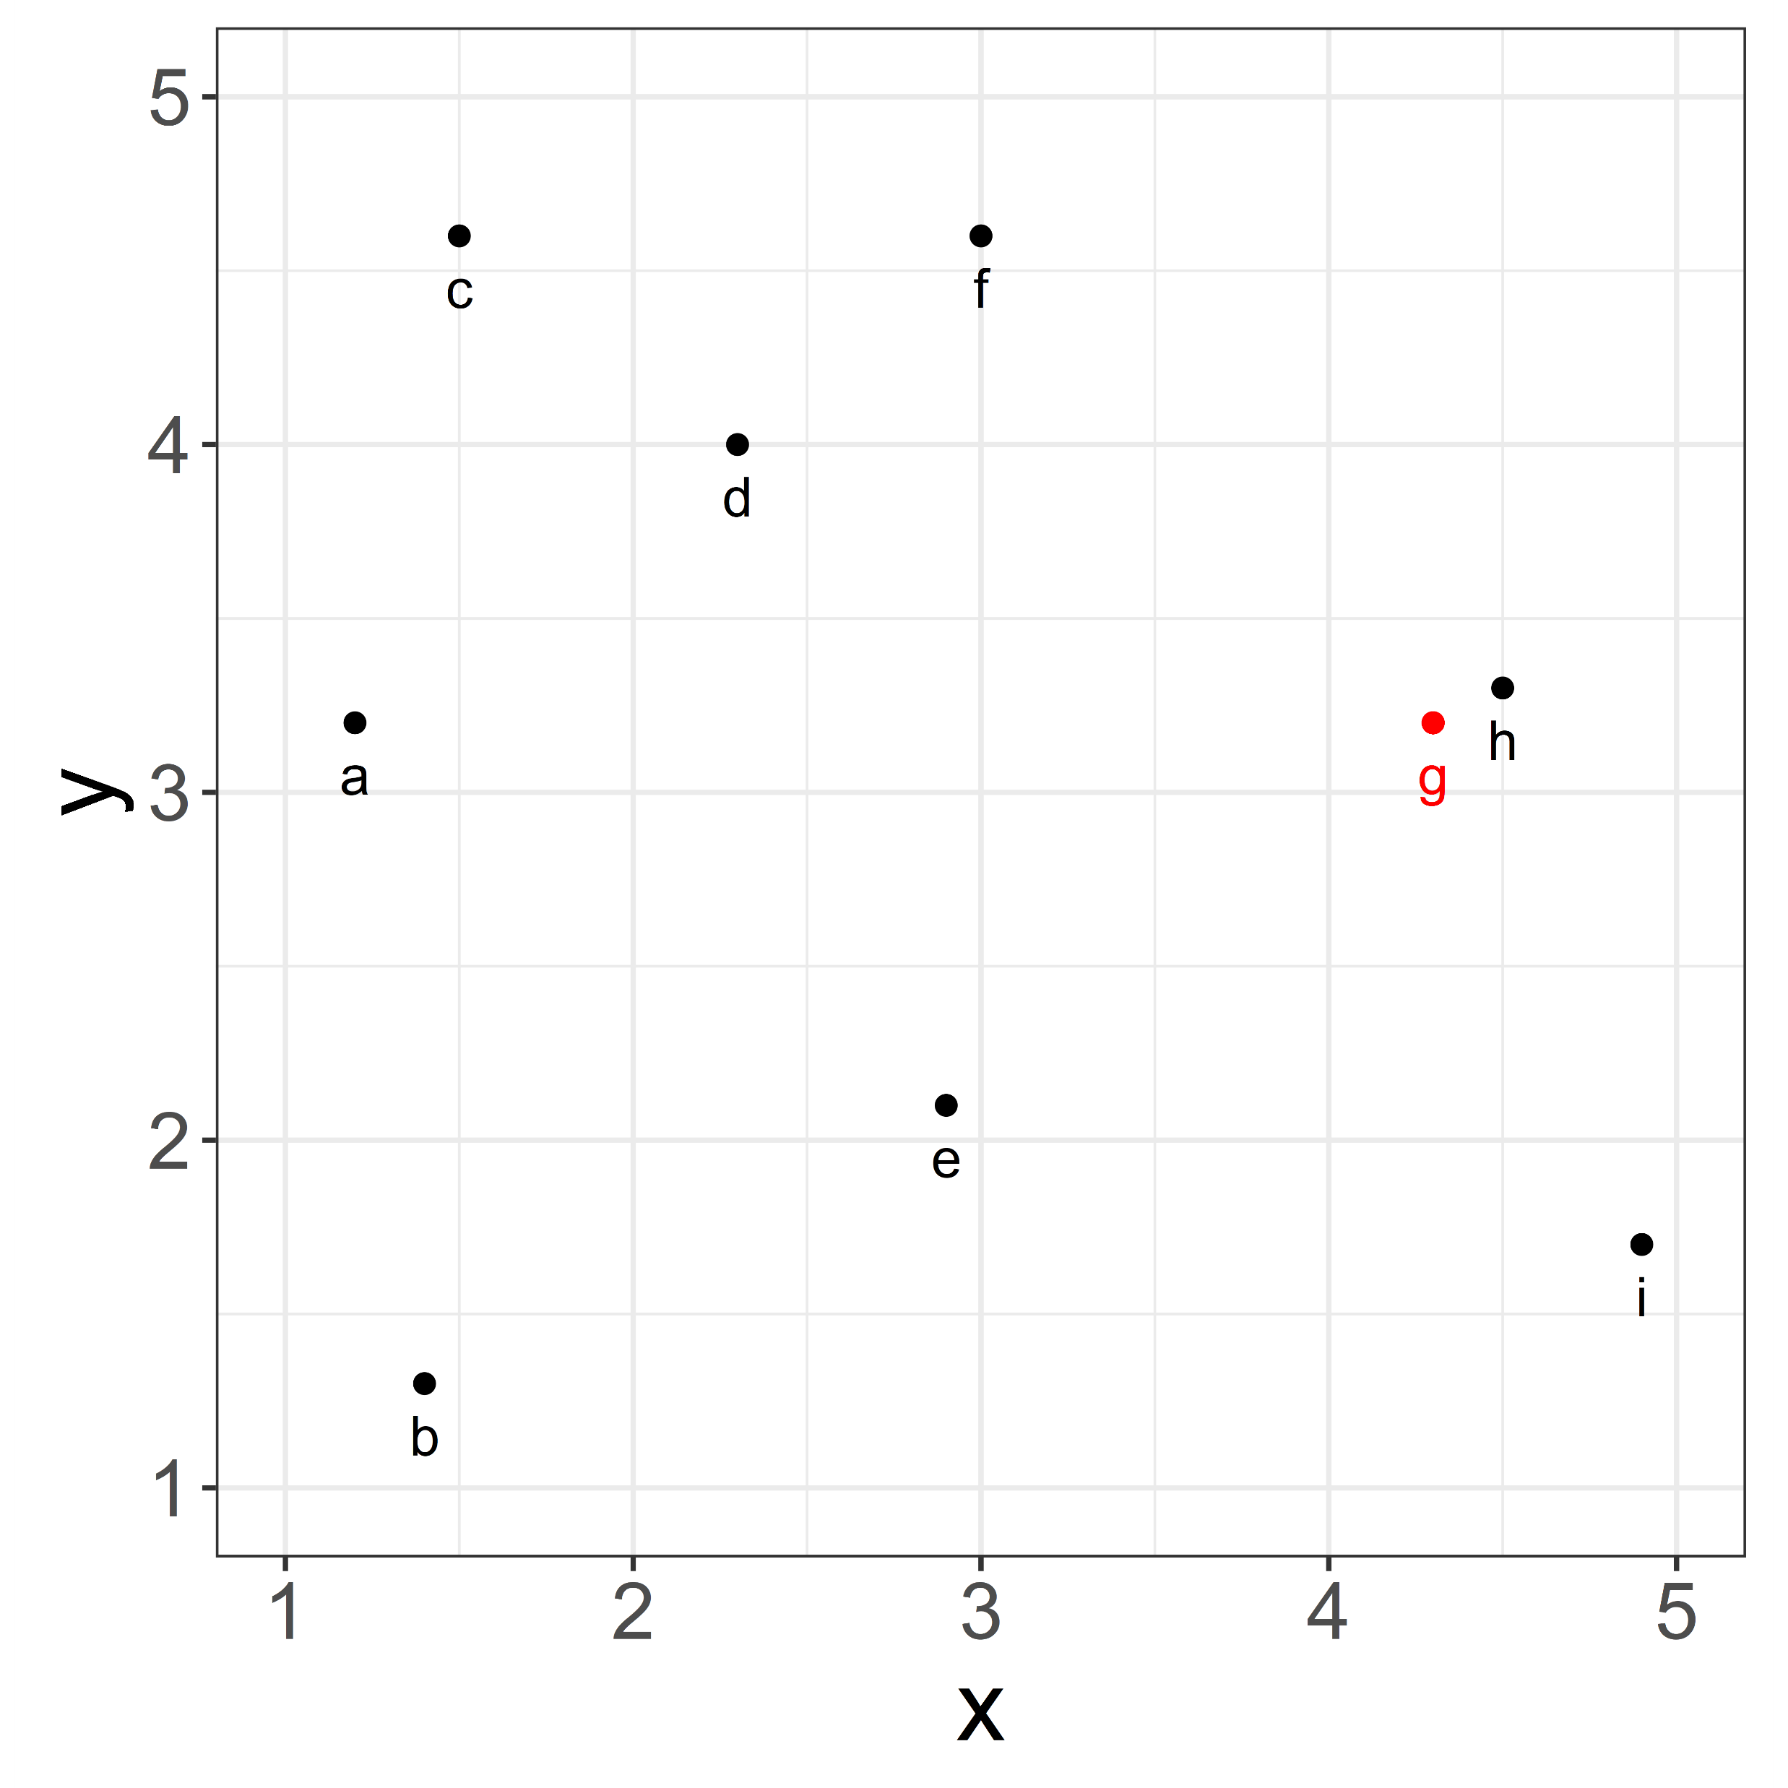
EUCLIDEAN DISTANCE
$$d\left(a, b\right)=\sqrt{\sum_{i=1}^{n}{{(w_{i}⋅(a_{i}−b_{i}))}^{2}}}$$
Can define an n-dimensional space, where each dimension is an individual numeric variable you want to control.
Categorical variables can be recoded into k-1 dummy-coded variables (e.g., to values of 0 and 1), where k is the number of categories.
Scale variables to have equal weighting.
Can weight dimensions by the relative importance of their variables being matched, $w_{i}$.
Can then identify items from each condition which are suitably close to each other in this space.

Slide 31
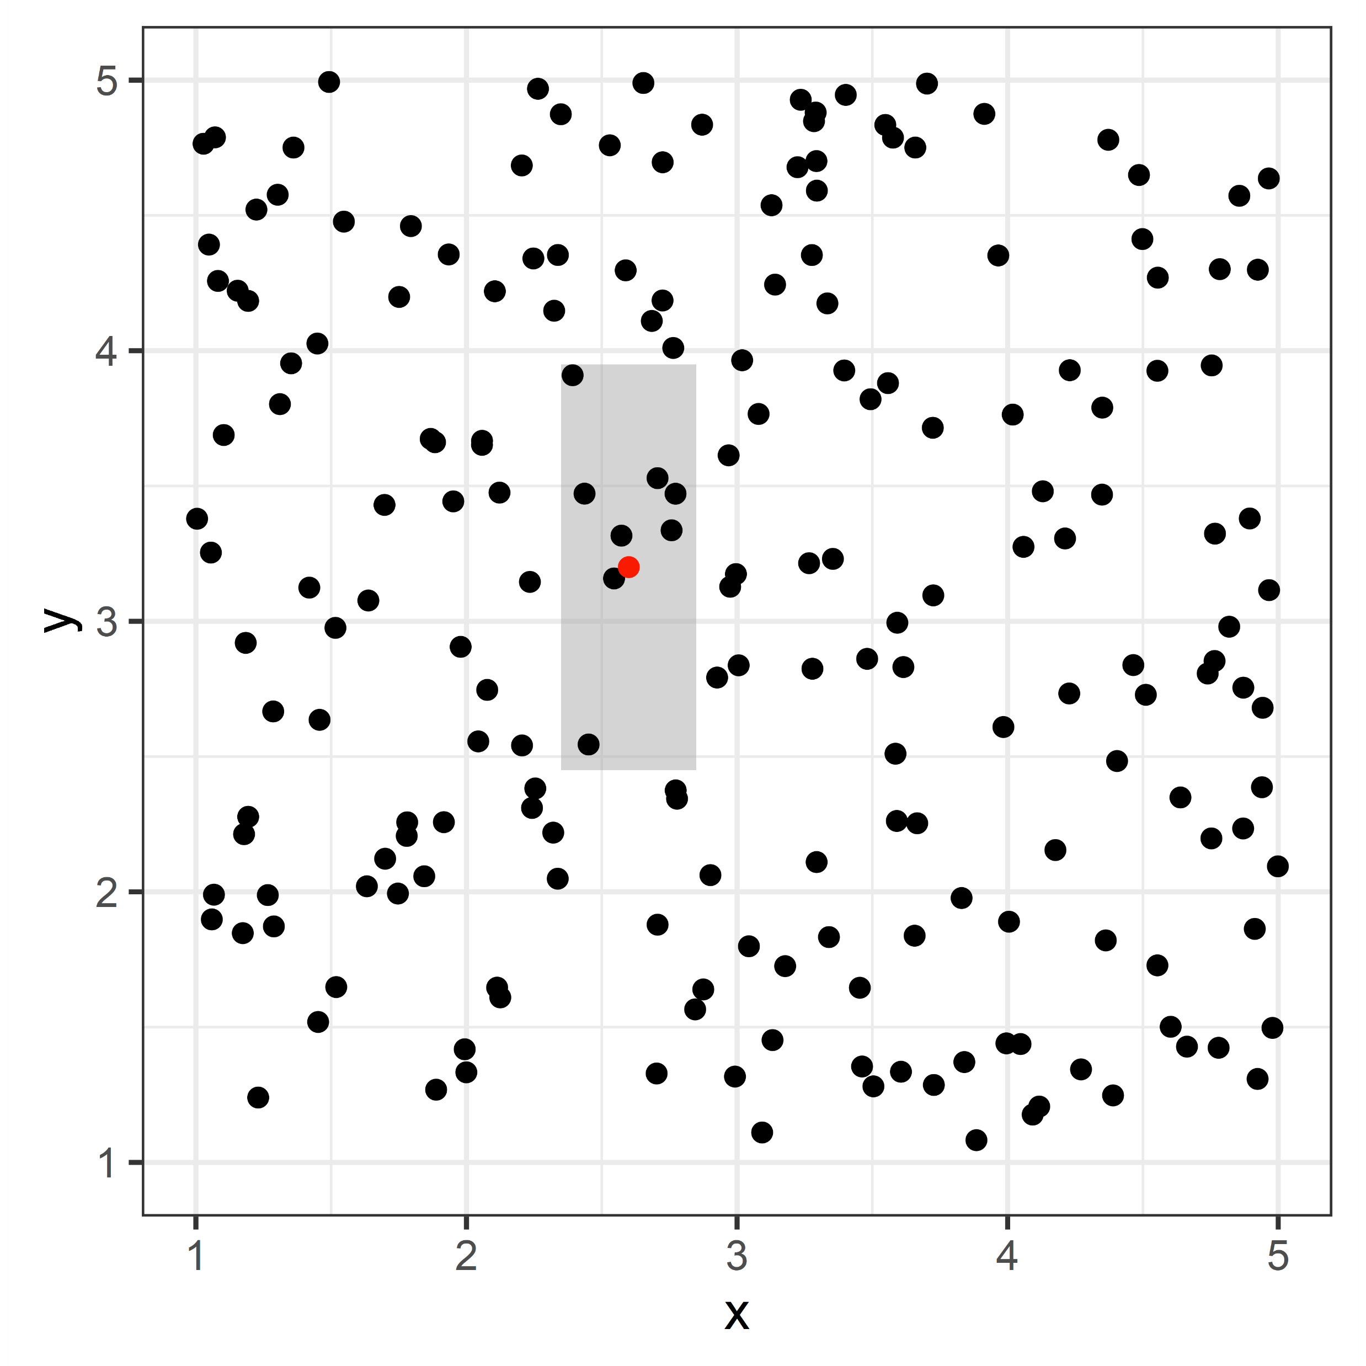
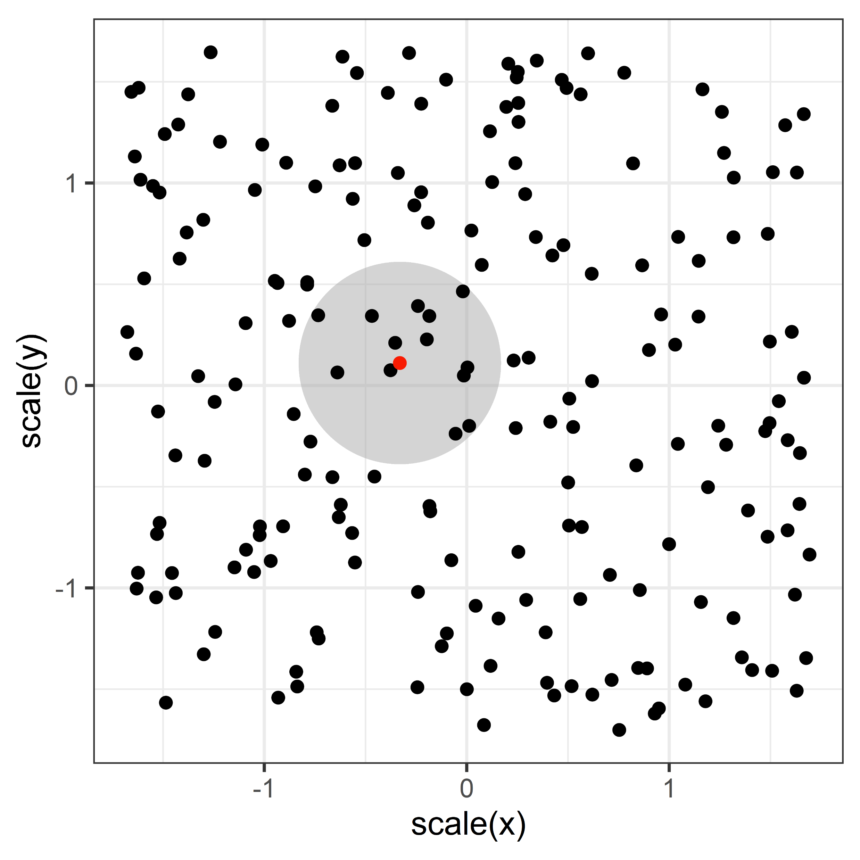
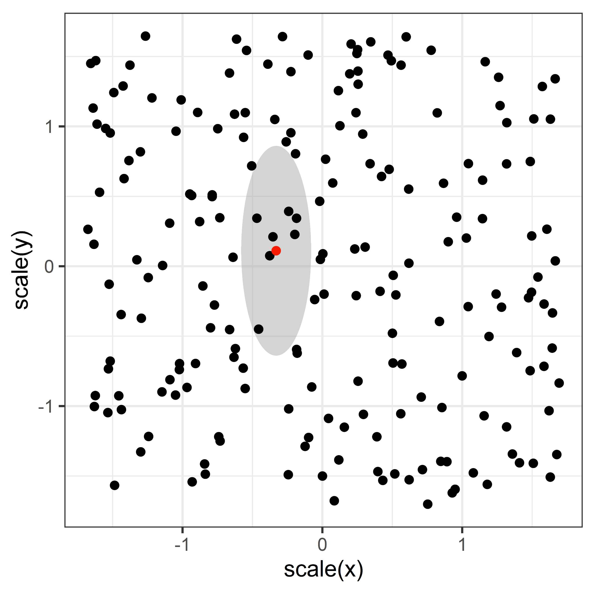
UNWEIGHTED EUCLIDEAN TOLERANCES
WEIGHTED EUCLIDEAN TOLERANCES
VARIABLE-SPECIFIC TOLERANCES
df %>% split_by(iv, “a” ~ ”b”) %>% control_for(x, -0.25:0.25) %>% control_for(y, -0.75:0.75) %>% generate(1)
df %>% split_by(iv, “a” ~ ”b”) %>% control_for_euc( c(x, y), 0:0.5 ) %>% generate(1)
df %>% split_by(iv, “a” ~ ”b”) %>% control_for_euc( c(x, y), 0:0.5, weights = c(3, 1) ) %>% generate(1)

Slide 32
An example with code

Slide 33
Other Useful LexOPS Functions
control_for_map() – Define higher-order controls which are calculated each iteration with a function. Lets you control for more complicated variables like semantic similarity.
split_random() – Perform a random split rather than splitting on a variable. This is useful for within subjects designs which alter things other than stimuli, e.g., task effects.
plot_sample() – See how representative the generated stimuli are on the variables in your design.
plot_iterations() – Diagnose the algorithm’s results. Shows the cumulative count of items generated over all iterations.
cite_design() – List the variables you’ve used which probably need describing and citing when you write up your methods.
run_shiny() – Run the LexOPS shiny app. This is a friendly GUI with lots of useful visualisation, which can translate options to reproducible LexOPS code.

Slide 34
https://github.com/JackEdTaylor/LexOPS

Slide 35
SOFTWARE PACKAGES FOR ITEM-WISE MATCHING
Package/Library | Language | No. Conditions | Type
designmatch | R | 2 | Optimal propensity score matching
Matching | R | 2 | Optimal propensity score matching
MatchIt | R | 2 | Optimal propensity score matching
LexOPS | R | 2-∞ | Tolerance matching
optmatch | R | 2 | Optimal propensity score matching
causalinference | Python | 2 | Optimal propensity score matching
matchpairs() function | MATLAB/OCTAVE | 2 | Optimal pairwise distance

Slide 36
Propensity Score Matching
Propensity Score: conditional probability of being assigned to a treatment (i.e., binary outcome), given a vector of covariates
Pairwise matching of propensity score across treatment and control ensures conditions do not differ in covariates
Can be used as:
Method for generating samples before an experiment
Method for accurately estimating effect size in observational study

Slide 37
Rounding Up
Part 4/4

Slide 38
Controlling for Variables when IVs are Continuous

Slide 39
Controlling for Variables when IVs are Continuous
Unnecessary binning of continuous variables can reduce sensitivity to effects
Can just use continuous predictors
Would still want to minimise the influence of confounding variables
One possible solution: minimise mutual information

Slide 40
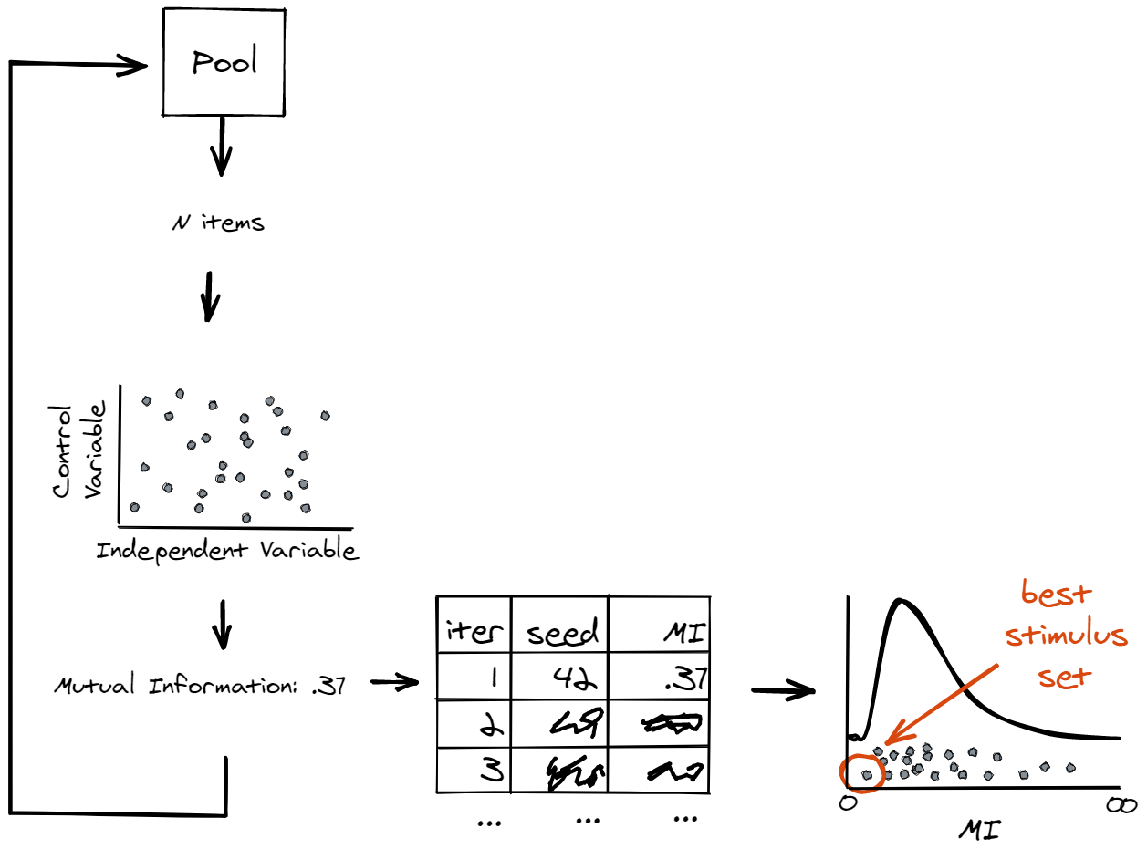
MINIMISING MUTUAL INFORMATION WITH CODE
Randomly pick a sample of items.
Calculate the mutual information between the predictor and control variable
Store the result and a seed to recreate the stimuli
Repeat the process many times
Select the best stimulus set (i.e., smallest MI)

Slide 41
Reporting Methods of Designing Stimuli

Slide 42
Reporting Methods of Designing Stimuli
Where did your pool of candidates come from?
Where did you get the data for the variables from?
What kind of matching/controlling did you use (item/distribution/continuous)?
How many iterations did you run?
How closely are items matched?
How many items did you create?
Can you visualise it?
Where is the code?
Even without the code, could someone reproduce your methods just from your description?

Slide 43
What not to do when reporting stimulus design
“Stimuli comprised 100 male faces and 100 female faces. Conditions were matched in terms of face width, face height, and age. Independent sample t tests confirmed that the conditions were suitably controlled (all p values > .05).” - Foo et al. (2005): Revisiting the Effect of Bar
“Stimuli comprised 100 male faces and 100 female faces. Items were matched pairwise in terms of face width, face height, and age. Paired sample t tests confirmed that the conditions were suitably controlled (all p values > .05).” - Foo et al. (2003): The Effect of Bar on Face Recognition

Slide 44
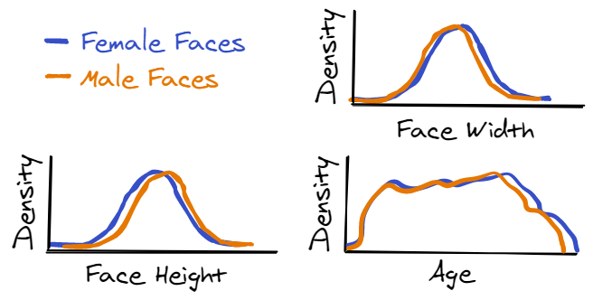
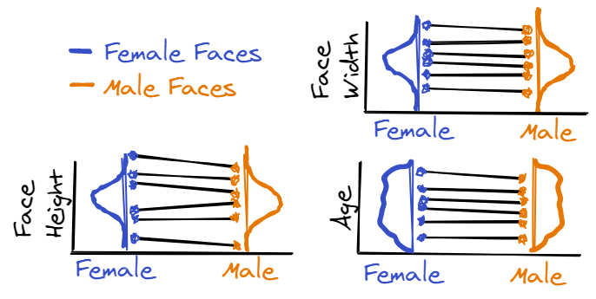
What to do instead
“Stimuli comprised 100 male faces and 100 female faces from the Chicago Face Database (Ma et al., 2015). The two conditions were matched on the distributions of face width, face height, and age by maximising the overlapping index (Pastore & Calcagni, 2019) between the two conditions. Overlapping index values were calculated using the overlapping package (Pastore & Calcagni, 2019) for R (R Core Team, 2020). Of 30000 random samples, the sample with the maximum overlap in all variables, between the two conditions, was selected. The full list of stimuli, and the code to generate it (with a seed for reproducibility) is available at osf.io/wdbiw. The selected stimuli are presented in Figure 1.”
“Stimuli comprised 100 male faces and 100 female faces from the Chicago Face Database (Ma et al., 2015). Faces were matched pairwise on the variables of face width (within ±1 pixel), face height (within ±5 pixels), and age (within ±0.5 years), using the LexOPS package (Taylor et al., 2020) for R (R Core Team, 2020). The full list of stimuli, and the code to generate it (with a seed for reproducibility) is available at osf.io/wdbiw. The selected stimuli are presented in Figure 1.”

Slide 45
Applications to things other than stimuli

Slide 46
Applications to things other than stimuli
Selecting matched participants from a pool for a between-subjects design
Analysis of megastudy data where you only analyse matched subsets of the data (common use of propensity score matching)
Dating?

Slide 47
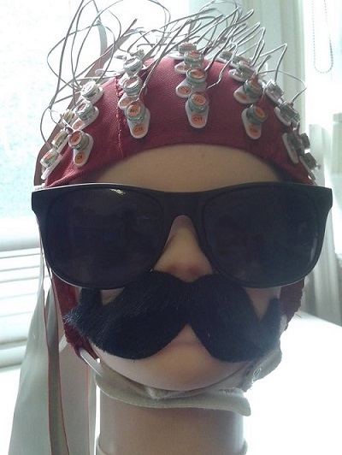
Summary, Questions, Answers
Design stimuli with code, and share the code, to be reproducible and save time
Report what you did specifically, and show the data with a visualisation
Sara Sereno
Guillaume
Rousselet
Alistair
Beith

